Slide 1
© 2018 Cengage Learning®. May not be scanned, copied or duplicated, or posted to a publicly accessible website, in whole or in part.

Slide 2
Advertising Messages and Marketing Communications
11
© 2018 Cengage Learning.® May not be scanned, copied or duplicated, or posted to a publicly accessible website, in whole or in part.

Slide 3
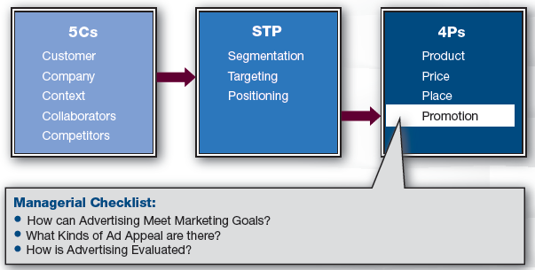
Marketing Framework

Slide 4
Discussion Questions #1
“Milk—It does the body good” and “Got milk?” are both advertisements for milk.
Which do you think is more effective? Why?
Why don’t the advertisements say “Smith’s Milk—it does the body good?”
Why do you think advertising is important?

Slide 5
What Is Advertising?
Advertising
Primary means to communicate with customers
Integrated Marketing Communications (IMC)
Message should be consistent and complementary across all media

Slide 6
Why Is Advertising Important?
Two reasons for importance
Facilitates customers’ awareness
Attempts to persuade potential customers that the brand is superior
Effect
Has both short- and long-term effects
Expected to generate sales but it is hard to prove
Advertising effects are cumulative

Slide 7
Goal Models (slide 1 of 3)
AIDA: Attention, Interest, Desire, Action
Capture attention
Pique interest
Make consumer desire the product
Get consumer to act (buy)

Slide 8
Goal Models (slide 2 of 3)
Other models
Awareness → knowledge → preference → brand conviction → purchasing
Awareness → interest → brand evaluation → trial → adoption
Ad exposure → message received → attitude change → intent to buy → buy

Slide 9
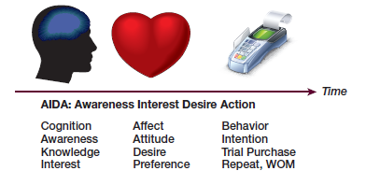
Goal Models (slide 3 of 3)
Three types of goals
Cognition: increase awareness and knowledge
Affect: enhance attitudes and associations
Behavior: encourage buying

Slide 10
Discussion Questions #2
Can you think of an ad that recently…
Got your attention?
Changed your knowledge?
Encouraged you to talk about it?

Slide 11
Goals Correlate to Product Life Cycle
Life cycle stages and advertising goals
Introduction: awareness and information
Growth: enhance positive attitudes
Maturity: remind consumers
Decline: reductions in ad spending

Slide 12
Designing Advertising Messages
Classic communication
Source (company) encodes message (ad)
Ad is transmitted
Receiver (customer) decodes the message
Copy testing makes sure target correctly understands the message

Slide 13
Cognitive Ads (slide 1 of 3)
Cognitive ads engage the consumer’s brain
Types of cognitive ads
One-sided argument: focuses on product’s benefits
Two-sided argument: gives pros and cons
Usually stand out more and are considered more objective

Slide 14
Cognitive Ads (slide 2 of 3)
Types of cognitive ads (continued)
Non-comparative ad: only one brand’s features, attributes, image, etc., are presented
Comparative ad: two or more brands’ features, attributes, image, etc., are presented
Ads created by the smaller company help the company and the competitor

Slide 15
Cognitive Ads (slide 3 of 3)
Types of cognitive ads (concluded)
Product demonstration: shows the product at work
Drama: product is the solution to a problem
Memorable

Slide 16
Emotional Ads (slide 1 of 2)
Types of emotional ads
Humor
May break through clutter & be buzz-worthy
Usually not cost efficient
May remember the joke but not the product
Fear ads
Use negative emotions
For a fear appeal to be effective, the ad must provide a solution to reduce the consumer’s fear

Slide 17
Emotional Ads (slide 2 of 2)
Types of emotional ads (continued)
Subliminal ads: contain elements shown too fast to detect consciously
Considered unethical and have never been shown to work

Slide 18
Image Ads
Ad message is more abstract
Company distinguishes itself by its image because the product’s category is crowded
Used for positioning

Slide 19
Endorsement Ads
Spokesperson provides a testimonial
Types of spokespeople
Celebrity
Spokes-characters
Experts
Regular people

Slide 20
How Endorsements Work (slide 1 of 2)
Elaboration likelihood model
Central route
Ad’s argument persuades
Occurs when customers are highly involved with brand and motivated to process the ad
Peripheral route
Ad’s peripheral cues persuade not argue
Occurs when customers are not involved with brand and not motivated to process

Slide 21
How Endorsements Work (slide 2 of 2)
Source credibility
Consumer interprets message as the most important piece of information, but also processes the credibility of the source
e.g., actors who play doctors on TV
Sleeper effect
Consumers forget the source over time, so its credibility doesn’t matter

Slide 22
Discussion Questions #3
Which type of ad would you recommend using to pitch:
Your university? Why?
Mother’s Against Drunk Driving (MADD)? Why?
A presidential candidate? Why?

Slide 23
Evaluating Advertising (slide 1 of 3)
Cognitive tests consider memory
Day-after recall tests (DAR)
Ask random samples of households “Which brands did you see last night?”
Recognition tests
When can’t remember more ads, ask “Do you remember seeing X ad?”
Mere exposure
Sheer familiarity from repeated exposure may enhance viewer’s favorability

Slide 24
Evaluating Advertising (slide 2 of 3)
Affective ads (image and preference)
Concept testing
3-4 focus groups of 8-10 screened participants are shown the ideas of the ad
Ads are usually in preliminary development
Consumers’ responses to ad, brand, etc., are evaluated

Slide 25
Evaluating Advertising (slide 3 of 3)
Affective ads (continued)
Copy testing
Large random samples of consumers view a TV program and ads; after 30 minutes, consumers take survey
Ad evaluation items
Stimulation (curious, enthusiastic, etc.)
Information (useful, credible, etc.)
Negative emotion (irritation, etc.)
Transformation (enjoyment, satisfied feeling, etc.)
Identification (felt involved with it, etc.)

Slide 26
A_{ad} and A_{brand}
Measure two attitudes
Attitudes-toward-the-ad (A_{ad})
Attitudes-toward-the-brand (A_{brand})
A_{ad} → A_{brand}→ likelihood to purchase
Testing methods
Dial during an ad copy test
Diagnostics

Slide 27
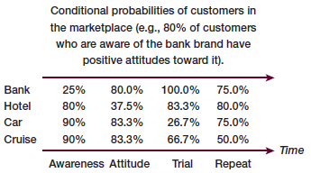
Discussion Questions #4
Which firm above has a problem with
Satisfaction?
Awareness?
Which brand would you most want to be associated with?

Slide 28
Managerial Recap (slide 1 of 2)
Set goals in order to evaluate ads
Classes of ad messages
Rational or cognitive ads
One- and two-sided arguments, comparative and non-comparative ads, product demonstrations, and dramas
Emotional ads
Humorous and fear-inducing appeals, image, and endorsements

Slide 29
Managerial Recap (slide 2 of 2)
Advertising is tested via concept testing and copy testing
Memory tests (recall and recognition)
Attitudinal tests
Behavioral measures

